Slide 1
Telecommunications Trends
Ronald L. Ramos
October 2015
Notes:
http://www.strategyand.pwc.com/perspectives/2015-telecommunications-trends
http://www2.deloitte.com/us/en/pages/technology-media-and-telecommunications/articles/2015-telecommunications-outlook.html#

Slide 2
Download the presentation at
http://talks.ronaldramos.info/

Slide 3
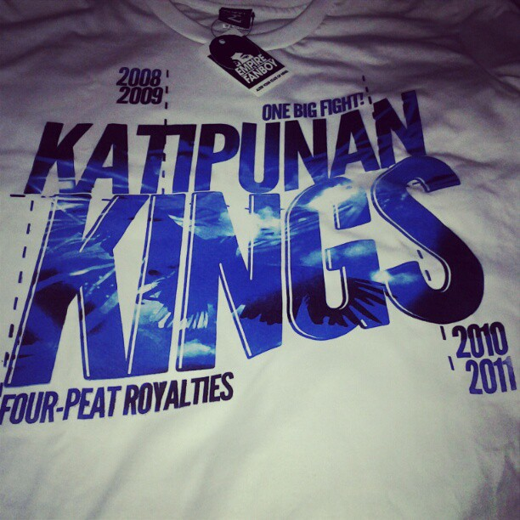
Ronald L. Ramos, PCD, Technology Group

Slide 4
The Digital World

Slide 5
Digitization
Conversion of analog information in any form (text, photographs, voice, etc.) to digital form with suitable electronic devices (such as a scanner or specialized computer chips) so that the information can be processed, stored, and transmitted through digital circuits, equipment, and networks.

Slide 6
The Digitization Megatrend
By the year 2020, an entire generation, Generation C (for “connected”), will have grown up in a primarily digital world.
Computers, the Internet, mobile phones, texting, social networking — all are second nature to members of this group.
Their familiarity with technology, reliance on mobile communications, and desire to remain in contact with large networks of family members, friends, and business contacts will transform how we work and how we consume.
Notes:
http://www.strategyand.pwc.com/global/home/what-we-think/digitization/megatrend
http://www.strategyand.pwc.com/global/home/what-we-think/multimedia/video/mm-video_display/digital-revolution

Slide 7
3 Forces of Digitization
Consumer pull
Consumers, and particularly Generation C, are already fully adapted to the digital environment.
Technology push
Digital technology continues to expand its influence. The infrastructure backbone of the digital world is bringing affordable broadband to billions of consumers.
Economic benefits
The economic benefits to be captured through digitization are real.
Notes:
Consumer pull: Consumers, and particularly Generation C, are already fully adapted to the digital environment. They naturally expect to be always connected, are willing to share personal data, and are more likely to trust referrals from their closest friends than well-known brands.
Technology push: Digital technology continues to expand its influence. The infrastructure backbone of the digital world is bringing affordable broadband to billions of consumers. In parallel, low-cost connected devices are being deployed in every industry, and cloud computing, and the vast information-processing machinery it requires, is developing quickly.
Economic benefits: The economic benefits to be captured through digitization are real. A wave of capital has poured into the new digitization technologies and companies, and the public markets reward early movers with unprecedented valuations

Slide 8
The Digital Future
The race to put new digital technologies at the service of customers has already transformed many industries, including media and entertainment, financial services, retail, healthcare, and utilities.
Companies are learning that digitization is no longer just a way to lower costs and boost productivity, but a means to offer delightful, compelling, digital experiences across all channels, leading to real top-line growth.

Slide 9
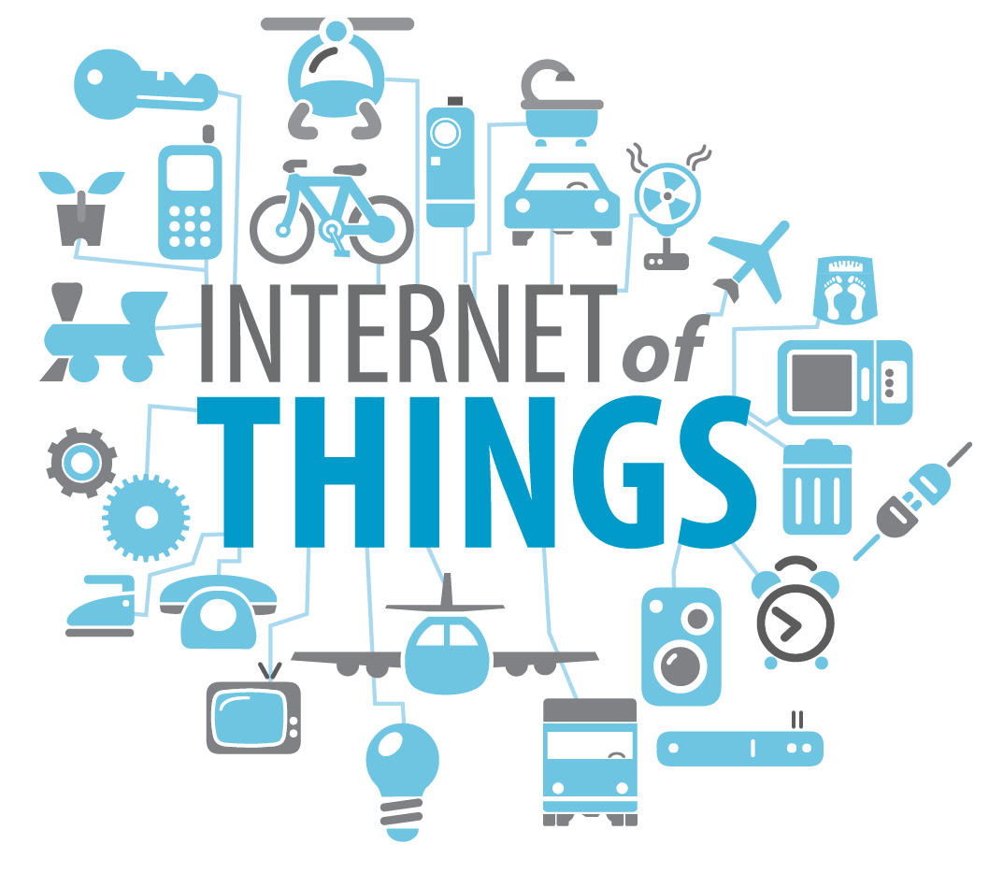
Internet of Things

Slide 10
Internet of Things (IoT)
The Internet of Things (IoT) is the network of physical objects or "things" embedded with electronics, software, sensors, and network connectivity, which enables these objects to collect and exchange data.

Slide 11
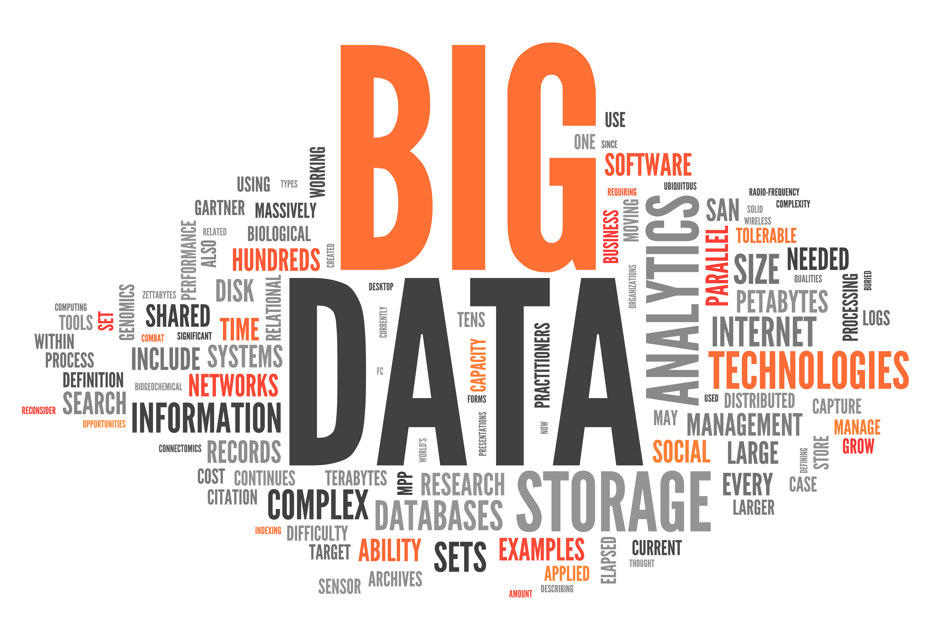
Big data

Slide 12
Big Data
Big data is a popular term used to describe the exponential growth and availability of data, both structured and unstructured.
The 3 Vs of Big Data:
Volume. Many factors contribute to the increase in data volume
Velocity. Data is streaming in at unprecedented speed and must be dealt with in a timely manner.
Variety. Data today comes in all types of formats
Notes:
Volume. Many factors contribute to the increase in data volume. Transaction-based data stored through the years. Unstructured data streaming in from social media. Increasing amounts of sensor and machine-to-machine data being collected. In the past, excessive data volume was a storage issue. But with decreasing storage costs, other issues emerge, including how to determine relevance within large data volumes and how to use analytics to create value from relevant data.
Velocity. Data is streaming in at unprecedented speed and must be dealt with in a timely manner. RFID tags, sensors and smart metering are driving the need to deal with torrents of data in near-real time. Reacting quickly enough to deal with data velocity is a challenge for most organizations.
Variety. Data today comes in all types of formats. Structured, numeric data in traditional databases. Information created from line-of-business applications. Unstructured text documents, email, video, audio, stock ticker data and financial transactions. Managing, merging and governing different varieties of data is something many organizations still grapple with.
The real issue is not that you are acquiring large amounts of data. It's what you do with the data that counts. The hopeful vision is that organizations will be able to take data from any source, harness relevant data and analyze it to find answers that enable 1) cost reductions, 2) time reductions, 3) new product development and optimized offerings, and 4) smarter business decision making. For instance, by combining big data and high-powered analytics, it is possible to:
Determine root causes of failures, issues and defects in near-real time, potentially saving billions of dollars annually.
Optimize routes for many thousands of package delivery vehicles while they are on the road.
Analyze millions of SKUs to determine prices that maximize profit and clear inventory.
Generate retail coupons at the point of sale based on the customer's current and past purchases.
Send tailored recommendations to mobile devices while customers are in the right area to take advantage of offers.
Recalculate entire risk portfolios in minutes.
Quickly identify customers who matter the most.
Use clickstream analysis and data mining to detect fraudulent behavior.

Slide 13
IP Technology

Slide 14
Internet Protocol
IP telephony (Internet Protocol telephony) is a general term for the technologies that use the Internet Protocol's packet-switched connections to exchange voice, fax, and other forms of information that have traditionally been carried over the dedicated circuit-switched connections of the public switched telephone network (PSTN).
Using the Internet, calls travel as packets of data on shared lines, avoiding the tolls of the PSTN.
The challenge in IP telephony is to deliver the voice, fax, or video packets in a dependable flow to the user. Much of IP telephony focuses on that challenge.

Slide 15
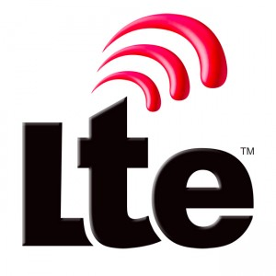

Slide 16
Long Term Evolution
LTE is a very good, easily deployable network technology, offering high speeds and low latencies over long distances.
It is Long Term Evolution of the Universal Mobile Telecommunications System (UMTS).
Notes:
So, what is LTE? To most, it is a faster network technology. To network operators around the world, it is a way to simplify their infrastructures to reduce costs while improving the quality of their offerings to subscribers. Advertisements by network operators declare it as the “most advanced” network technology. In the end, it is Long Term Evolution of the Universal Mobile Telecommunications System (UMTS). LTE-Logo
But that doesn’t tell us what LTE actually is. LTE is what the 3GPP (3rd Generation Partnership Project, the group responsible for standardizing and improving UMTS) designates as their next step. UMTS is the group of standards that define 3G for GSM networks across the world, including AT&T and T-Mobile’s 3G networks. The cdmaOne/CDMA2000 family of standards are not maintained by 3GPP, but by a different organization spearheaded by Qualcomm. For subscribers to operators with networks utilizing CDMA2000 technology, LTE is the replacement of mediocre CDMA2000 networks with a superior cellular telecommunications system offering flexibility and power to the network operator and the subscriber.
LTE is a very good, easily deployable network technology, offering high speeds and low latencies over long distances. For example, two of the four operators’ LTE networks in New York City were rated well for achieving this goal. Verizon’s LTE service was rated with an average download speed of 31.1Mbps and an average upload speed of 17.1Mbps. T-Mobile’s LTE service was rated with an average download speed of 20.5Mbps and an average upload speed of 13.5Mbps.

Slide 17
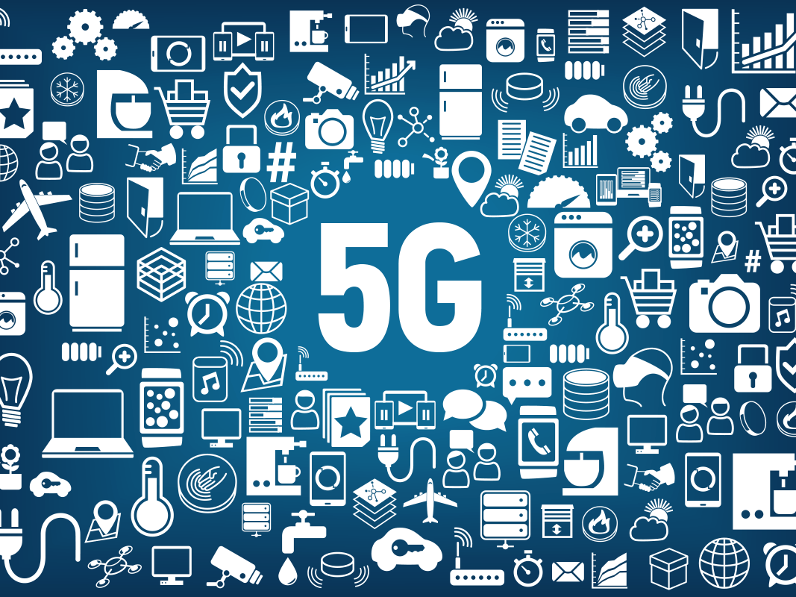
5G

Slide 18
5G
5G is the next generation mobile and wireless connectivity system. Key requirements are that it should offer far greater capacity and be more responsive to users’ needs, more energy-efficient and more cost-effective than anything that has gone before.
The need for the 5G network is being driven by the ever-increasing demand for mobile data and the emergence of the Internet of Things (IoT), through which billions of devices will become connected. In the future, technologies such as Smart Cities, non-intrusive healthcare and advanced logistics will require much shorter network response times to enable very rapid reactions. At the same time there is a pressing need to reduce end user costs (to ensure applications are widely accessible) and to minimise energy consumption.

Slide 19
3G to 5G

Slide 20
Monetize and Digitize

Slide 21
Monetize and Digitize
The transformational impact of digitization (the mass adoption of connected digital technologies and applications by consumers, enterprises, and governments) continues to drive telecommunications operators’ most critical strategic and operational decisions.
This trend governs how telecom companies try to monetize their infrastructure investments and exploding data traffic, boost newly needed capabilities, rationalize their product and service offerings, improve the customer experience, and evolve their asset portfolios and business models.
Notes:
So far, the results have been mixed. Global operators’ revenues are stagnating, even as operating and capital expenditures are increasing. Meanwhile, the “over-the-top” (OTT) players — video, audio, and other services such as Netflix and Spotify that piggyback free on telecom systems — are gaining in number and popularity, making the traditional operators’ task that much more difficult.
Telecom operators that have adopted aggressive digitization strategies are generally faring better than their more conservative rivals, although the transition has not been smooth. In some cases, early digital initiatives have been scattershot, and many telecom companies have learned that they must take a more focused approach in determining which digital products and services to offer if they are to capture real opportunities in adjacent businesses and broader digital ecosystems.

Slide 22
Digitization of Core Business

Slide 23
Most telecom operators understand the potential benefits — consumer satisfaction, enhanced revenue streams, and cost savings — that can be reaped by providing compelling online digital experiences as well as service automation and more efficient, straight-through processing of financial transactions.
Notes:
Most telecom operators understand the potential benefits — consumer satisfaction, enhanced revenue streams, and cost savings — that can be reaped by providing compelling online digital experiences as well as service automation and more efficient, straight-through processing of financial transactions. For many companies, however, complex legacy architectures and systems and legacy products and services stand in the way of making meaningful inroads into the digital experience. Indeed, because of their size and relative agility, smaller telecom companies appear to be better prepared to pivot away from older systems and provide truly customer-friendly business processes.
For telecom providers, incremental efforts are unlikely to remedy the situation. Instead, companies must completely redefine their relationship with their customers. They must prove that they can offer high-quality, state-of-the-art, and reliable communications services; popular and fresh content on mobile and desktop platforms; and consumer-friendly websites with online billing, troubleshooting, scheduling, and account support. They also should sell their expertise in security, identity authentication, and billing to their business customers. And they must work to monetize the mountains of data that flow through their networks by shifting to experience-based pricing, phasing out unlimited and free data plans, and promoting the consumption of data-heavy content.
These efforts will require significant investments in new networking technologies as companies continue to deploy 4G networks and develop new 5G systems. Funding should come from optimizing operating costs, in part by using small-cell networks to regulate the available spectrum more efficiently and improving network performance with new management technologies such as software-defined networking and network functions virtualization.

Slide 25
Digitization of industries

Slide 26
We live in an ever more connected world. The concept known as the Internet of Things (IoT), will soon link all manner of devices, from toothbrushes to cars to entire cities, into larger and larger networks. The price of connectivity itself is declining, and the enabling devices, such as smartphones and tablets, are themselves becoming less expensive, more powerful, and ubiquitous.
Notes:
We live in an ever more connected world. The concept known as the Internet of Things (IoT), will soon link all manner of devices, from toothbrushes to cars to entire cities, into larger and larger networks. The price of connectivity itself is declining, and the enabling devices, such as smartphones and tablets, are themselves becoming less expensive, more powerful, and ubiquitous.
These advances should be a boon for the telecom industry, offering the possibility of further monetizing the additional network traffic. Already, telecom firms are taking advantage of this new user base of people and things by developing a variety of new services, sometimes in partnership with other companies. For example, in the U.S., AT&T is working with IBM on a smart cities program, and Spain’s Telefónica offers an IoT product called Thinking Things that lets individuals develop programs to adjust climate and lighting in rooms, offices, and buildings currently and in the future to control all of the home and office equipment and data they interact with. In conjunction with companies such as Nespresso and Coca-Cola, the U.K.’s Orange has launched a machine-to-machine (M2M) communications system. Germany’s Deutsche Telekom is supporting the digitizing of manufacturing with its Industrie 4.0 initiative. And an Indian firm, Bharti Airtel, is in a joint venture with the State Bank of India to develop mobile banking apps for people unable to access a local branch. Providing such farsighted services for all kinds of industries, equipment, and individual needs is essential for every innovative telecom operator.
Because many of these new services are managed in cloud-based systems, the digital environment will require a higher level of security and privacy protection than currently exists. That potentially presents yet another opportunity — it could be called a duty — for telecoms to set the benchmarks and standards for safeguarding the sensitive personal information shared by consumers, companies, and machines over these ubiquitous networks.

Slide 28
Building digital ecosystems

Slide 29
Telecom providers have begun to pursue growth through innovative digital ecosystems designed around joint ventures, acquisitions, or internal R&D.
For telecom companies, success will depend upon gaining a deeper understanding of coherent digital ecosystems, developing or acquiring the capabilities needed to implement digital ecosystems, and making sure the ecosystem is greater than the sum of its parts.
Notes:
Recently, telecom providers have begun to pursue growth through innovative digital ecosystems designed around joint ventures, acquisitions, or internal R&D. Sweden’s TeliaSonera, for example, has taken a stake in Zound Industries, a provider of fashionable accessories for electronics, while Australia’s Telstra has invested in digital signatures through DocuSign and in video platforms through Ooyala. Deutsche Telekom Capital Partners has set aside US$620 million to fund German startups. Many major global operators have established their own independent incubators or venture funds focused on digital innovation, and created satellite offices in the Silicon Valley region to gain access to ideas for next-generation services.
Telecom companies have begun to pursue growth through innovative digital ecosystems.
However, developing ecosystems of digital components and applications that can seamlessly provide complementary and synergistic services and products is no easy task, especially given the head start that companies such as Apple and Google already have in covering a range of interwoven communications, multimedia, shopping, entertainment, and financial offerings. For telecom companies, success will depend upon gaining a deeper understanding of coherent digital ecosystems, developing or acquiring the capabilities needed to implement digital ecosystems, and making sure the ecosystem is greater than the sum of its parts. In most cases, this means entering into the right partnerships, developing the application program interfaces needed to create apps, and offering business customers big data analysis, mobile payment programs, and mobile advertising solutions. Without these capabilities, telecoms are unlikely to thrive in this highly competitive arena.
The requirements for digital ecosystems differ significantly for consumers and for business customers. Whereas the former can accept beta-level products, business customers demand more reliable and secure services. In this regard, because of their vast experience and significant capabilities in providing high-quality, well-managed, and dependable networks, telecom operators are already well positioned to fulfill these needs.

Slide 31
Any questions?

Slide 32
End of Presentation
Thank you!

